Slide 1
Analysis on Sales Data
NP GANESH
PGDM Data Science @ Manipal
ganesh.nethip@gmail.com
9704242880

Slide 2
Agenda
Understanding of Data and Data Facts
Company’s Performance Over time
Important trends and Insights
Customer acquisition and loyalty
Type of Customers
Suggestions for company to take some initiatives
Country wise sales

Slide 3
Data Facts
Given sales data and dates data
There are sold transactions as well as cancelled transactions
Data recorded from 2010 Dec to 2011 Dec (13 Months)
Most of the transactions made are recorded from United Kingdom
4070 Unique Products and 4373 Unique customers
25900 Unique transactions (irrespective of cancellation)
Transactions were made across 38 countries
November month stands tall in sales
There were no transactions made on saturday

Slide 4
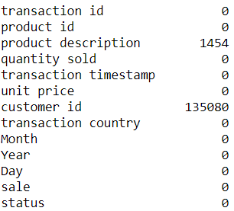
Missing Values
Product Description and Customer ID consists of missing values

Slide 5
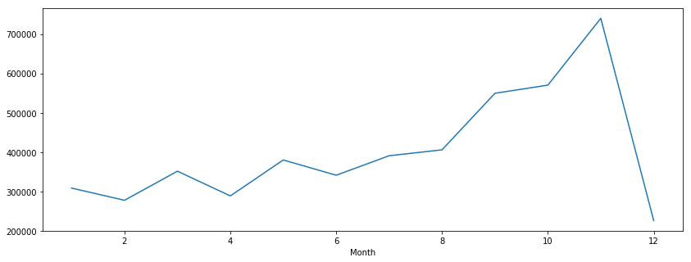
Is the company's performance improving or degrading over time?
Sum(quantity sold)
Based on monthly products quantity sold, it looks the company’s performance in selling products has grown and reached the maximum in November and sudden drop in December.

Slide 6
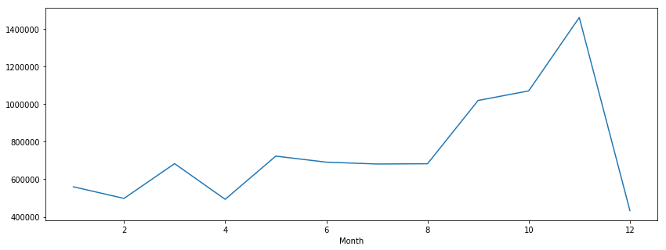
Is the company's performance improving or degrading over time?
Revenue generated
Using Quantity Sold and Unit price, created new column total revenue(per sale)
Based on revenue, it looks the company’s performance in making revenue has grown and reached the maximum in November and sudden drop in December.
It is obvious insight because more products are sold in November only.

Slide 7
Examine and highlight important trends visible in the sales data and insights
Count of cancelled products – 9288
Count of Sold Products – 541909
1.71% of products were cancelled in different transactions

Slide 8
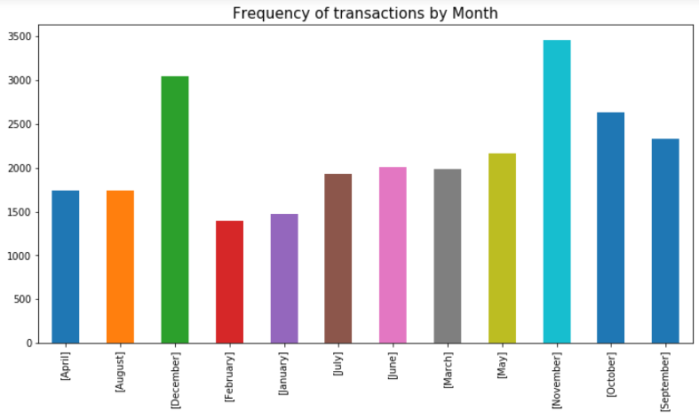
Transaction count
November and December are the months with most transactions made
Overall year ending months are more valuable for sales (according to data)

Slide 9
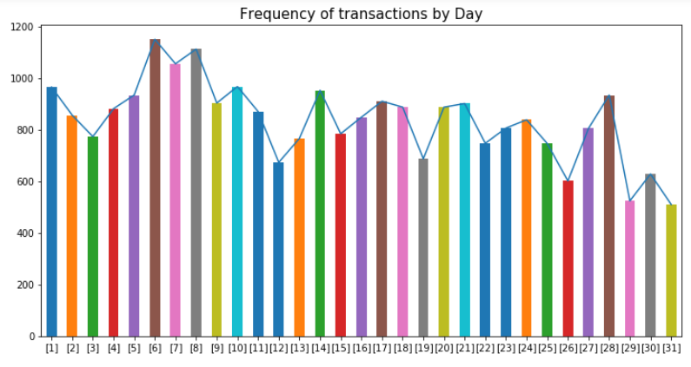
Transaction count
This is combined analysis of 2010-11(Only Sold Products)
It looks first 8 days of a month are recorded with most transactions
When it comes to end of the month the count of transactions are completely different, there may be multiple reasons for that (Ex: Stock issues, Customer income)

Slide 10
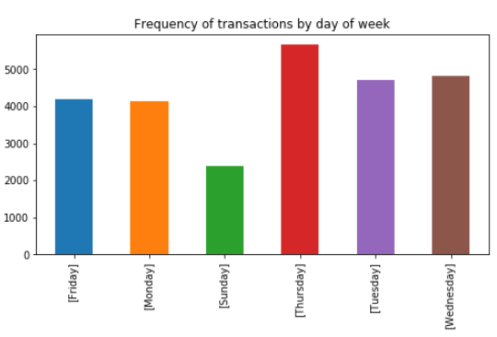
Transaction count
This is combined analysis of 2010-11(Only Sold Products)
There were no transactions made on Saturdays
It looks Mid of a week is always busy with transactions (Tuesday, Wednesday, Thursday)
Sundays has less frequency of transactions when compared to other days of a week.

Slide 11
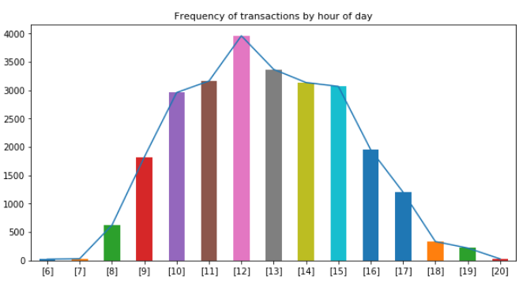
Transaction count
This is combined analysis of 2010-11(Only Sold Products)
In a day, it looks from 10:00 am to 3:00 pm are busy hours.

Slide 12
How can we measure our performance in terms of customer acquisition and building customer loyalty?
Customer loyalty is same customer making purchases several times.
Identifying the customers who are repeating purchases.
Identifying what are the items they are purchasing most.
Suggesting to give special discounts on those items and send mailers to those customers to enhance sales.
Identifying sales at first buy and reorder.
Sales of first Buy and reorder month wise.

Slide 13
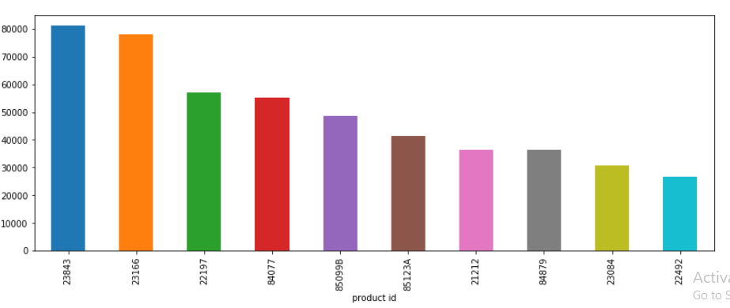
Top 10 Sold Products
Quantity sold
Top 10 products based on Quantity Sold

Slide 14
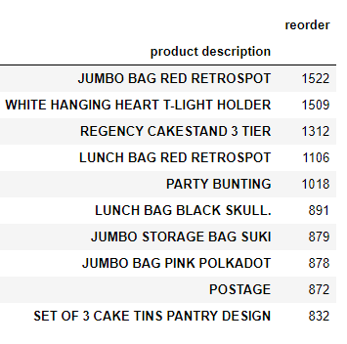
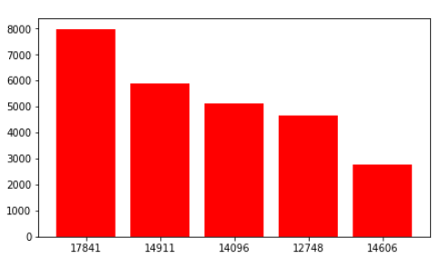
Customer id
Top 5 Customers Who made more transactions through out years
Top 10 Reordered Products

Slide 15
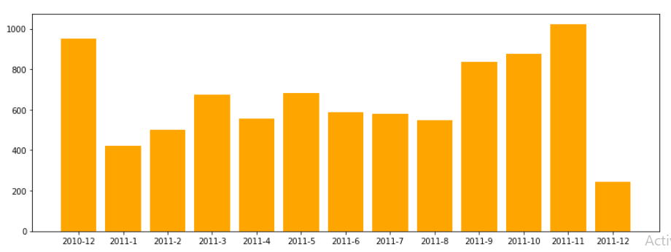
No of unique customer
Year-month
No.of Unique customers acquired by company in every month of year
2010- Dec and 2011- Nov acquired more customers
Shockingly 2011-Dec acquired very less customers

Slide 16
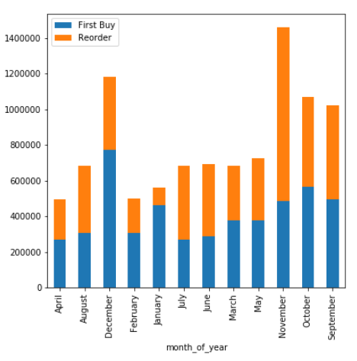
Reorders is derived from customer id, product id and time stamp
First buy and reorder sales per month gives an insight how customer purchasing on their first visit and further visits.
Useful in case of data like basket capacity or purchase of each customer and how the revenue differs from first buy and next buy of individual customer.

Slide 17
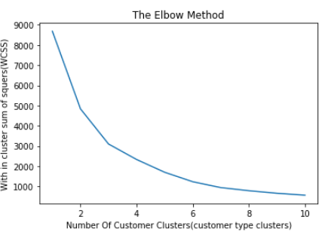
What kind of customer do typically buy from us?
What kind of customers do typically buy from us can me derived using customer Segmentation
Customer Segmentation can be done using Clustering
To ensure the accurate no of clusters, I used Elbow method.
The graph tells there are 3 groups in data

Slide 18
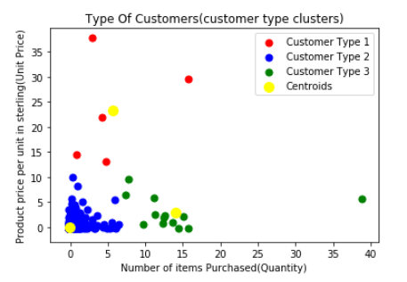
The customers are segmented with help of clusters
Three clusters are formed based on customer id, quantity sold and revenue generated(using product price per unit)
There are more customers who purchase less no of items and also prices of those products will be very low (Ex: Group 1)
There are very less customers who purchase more no of items with low prices of products (Ex: Group 2)

Slide 19
Identify relationships and drivers of sales that might be hidden in the dataset. Can we take some initiatives based on the data to increase the sales? Also mention, based on data can we avoid out of stock situations?
One is identifying repeating customers and giving special discounts on the items they purchase regularly.
By seeing in a month what are the items are purchased in what quantity. Accordingly we can say the quantity to be kept as stock for the next month.
November and December are the months acquiring more customers, more transactions and more revenue, this may be because of festival season in the respected countries.
In those busy months if company initiating new offers and festival discounts then company can generate more revenue than recorded.
In other months of an year company should identify inactive customers and send them reminders with some exciting offers
According to the given data there are 1890 inactive customers

Slide 20
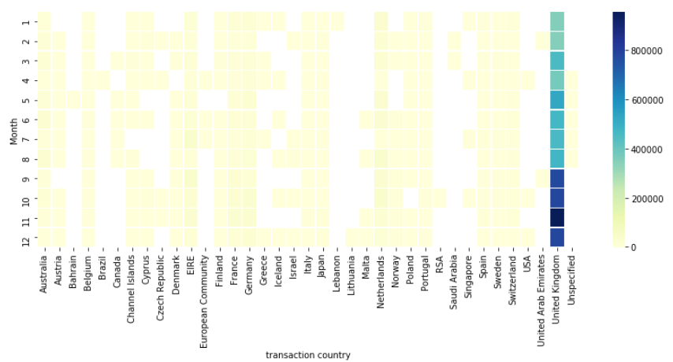
The above heat map tells more revenue/month generated only in United Kingdom.
Rest other countries are showing poor results in transactions, customers and sales.
To overcome this, company should concentrate on other countries too to increase their sales over globe.

Slide 21
Thank You for the opportunity
- NP Ganesh

